Slide 1
AAKASH MURALI (4344)

Slide 2
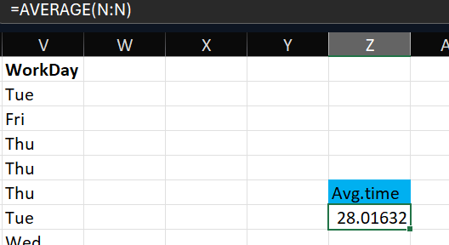
1)Average lead time between the reqdate and wokdate for all work orders.
After formatting the req and wok date ,the average lead time between the req and wok date is found to be 28.01 days, which is found with the formula “=average()”.

Slide 3
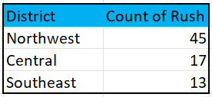
2)Which district has the highest number of rush jobs.
After filtering the districts and finding the count of rush jobs every district has , it is found that “Northwest” has the highest number of rush jobs at 45.

Slide 4

3)How does the average labour hours differ between the rush and non-rush jobs.
After filtering the jobs based on “rush” and “non-rushed”, we can find the average LbrHrs for the respectives fields and is noted that rush jobs take less hours than the non rush jobs.

Slide 5
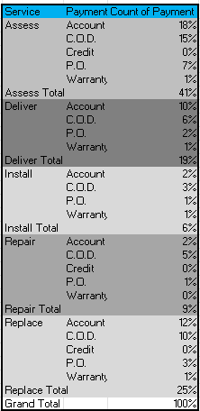
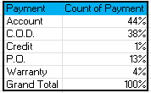
4)What is the distribution of payment types across different services?
With services and payment type as fields , we hereby found the distribution of various types for every service and it is noted that payment type “Account” is most used type with “warranty” and “Credit” being the least used account type.

Slide 6
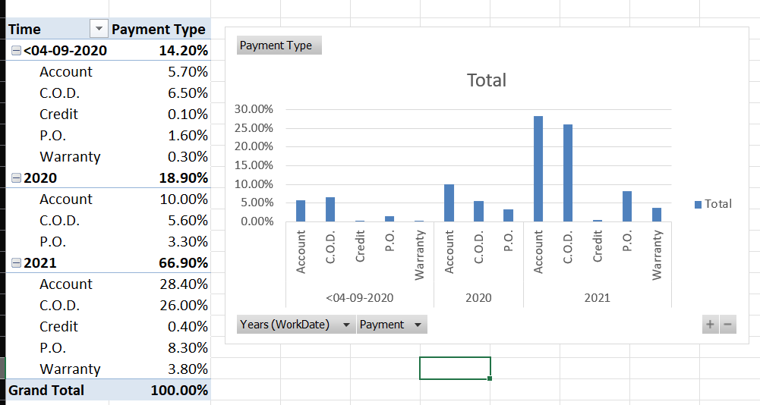
5)Are there any trends in distribution of payment type over time ?
After findind the distribution of payment type over years with a chart , it is noted that “Account” usage has been constant increasing over the years, currently being the top type, and “C.O.D” having a exponential rise In the recent years.

Slide 7
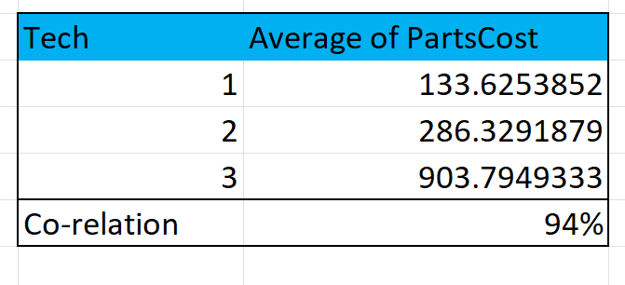
6)Is there a relationship between the number of technicians req and the cost of the parts?
After filtering the tech and parts cost and finding the co-relation between “tech” and “average cost of parts” we come to know that there is indeed a high relevance b/w the “tech” and “average part cost” (ie)They are directly propotional to each other , when one increases , so does other.

Slide 8
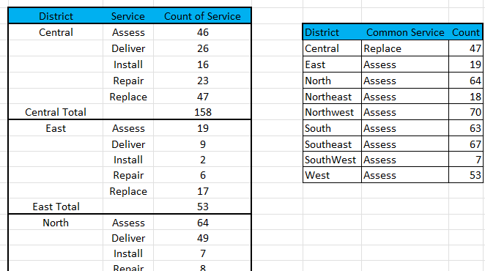
7)Most common type of service requested in each district.
After finding the count of various services over the districts , we can come to a conclusion that these are the most common requested services for the various districts.

Slide 9
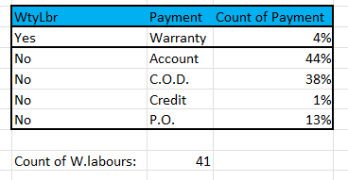
8)Is there any difference in distribution of payment types for those who work under Warranty labour and those who don’t?
There are total of 41 people who work under Warranty labour and it is noted that all those people are under the “warranty” payment type ,which contributes 4% of total distribution among all the employees.

Slide 10
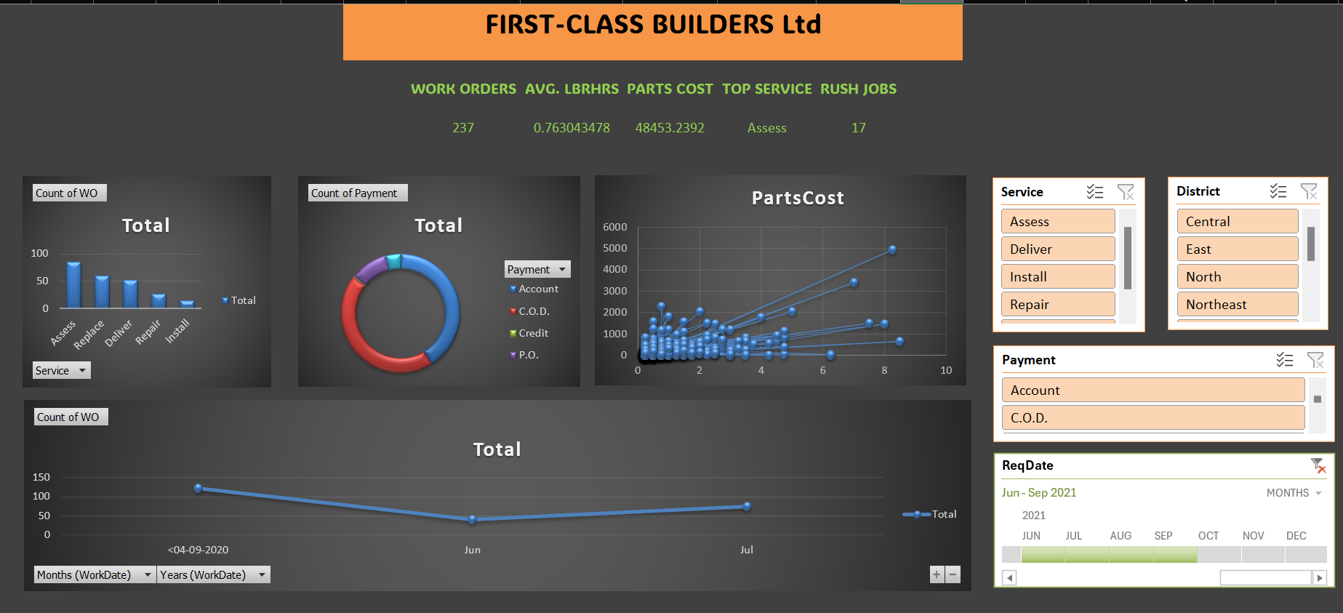
DASHBOARD
Text.

